Slide 1
Data Preparation Analysis Project Presentation
Group 16
Abhirama Krishna Muppasani,
Sai Shashank Satuluri
Saketh Reddy Beeravolu
Shreeraj Manusanipalli
Professor – Oleksandr Narykov

Slide 2

Steps
Preprocessing
Finding the correlation coefficient
Visualizing the data using plots
Dimensionality reduction
Unsupervised learning implementation
Cross validation
Simple Model ( Linear Regression)
Tune the Hyperparameters

Slide 3
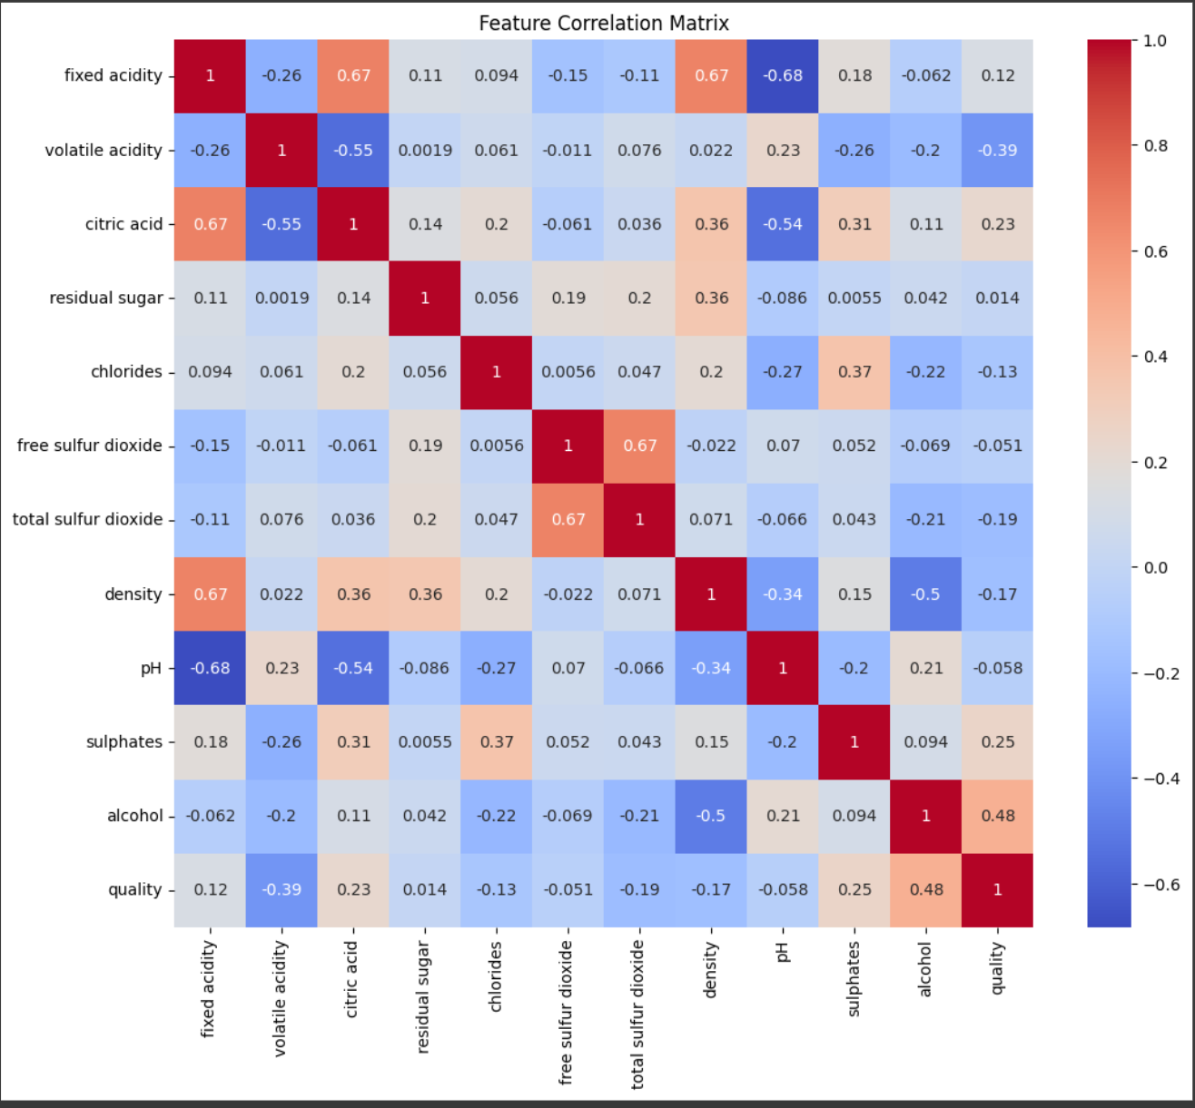
Finding the Correlation Coefficient
We use the inbuilt function to get the Corelation between Features.
We visulaise them using a heatmap.

Slide 4
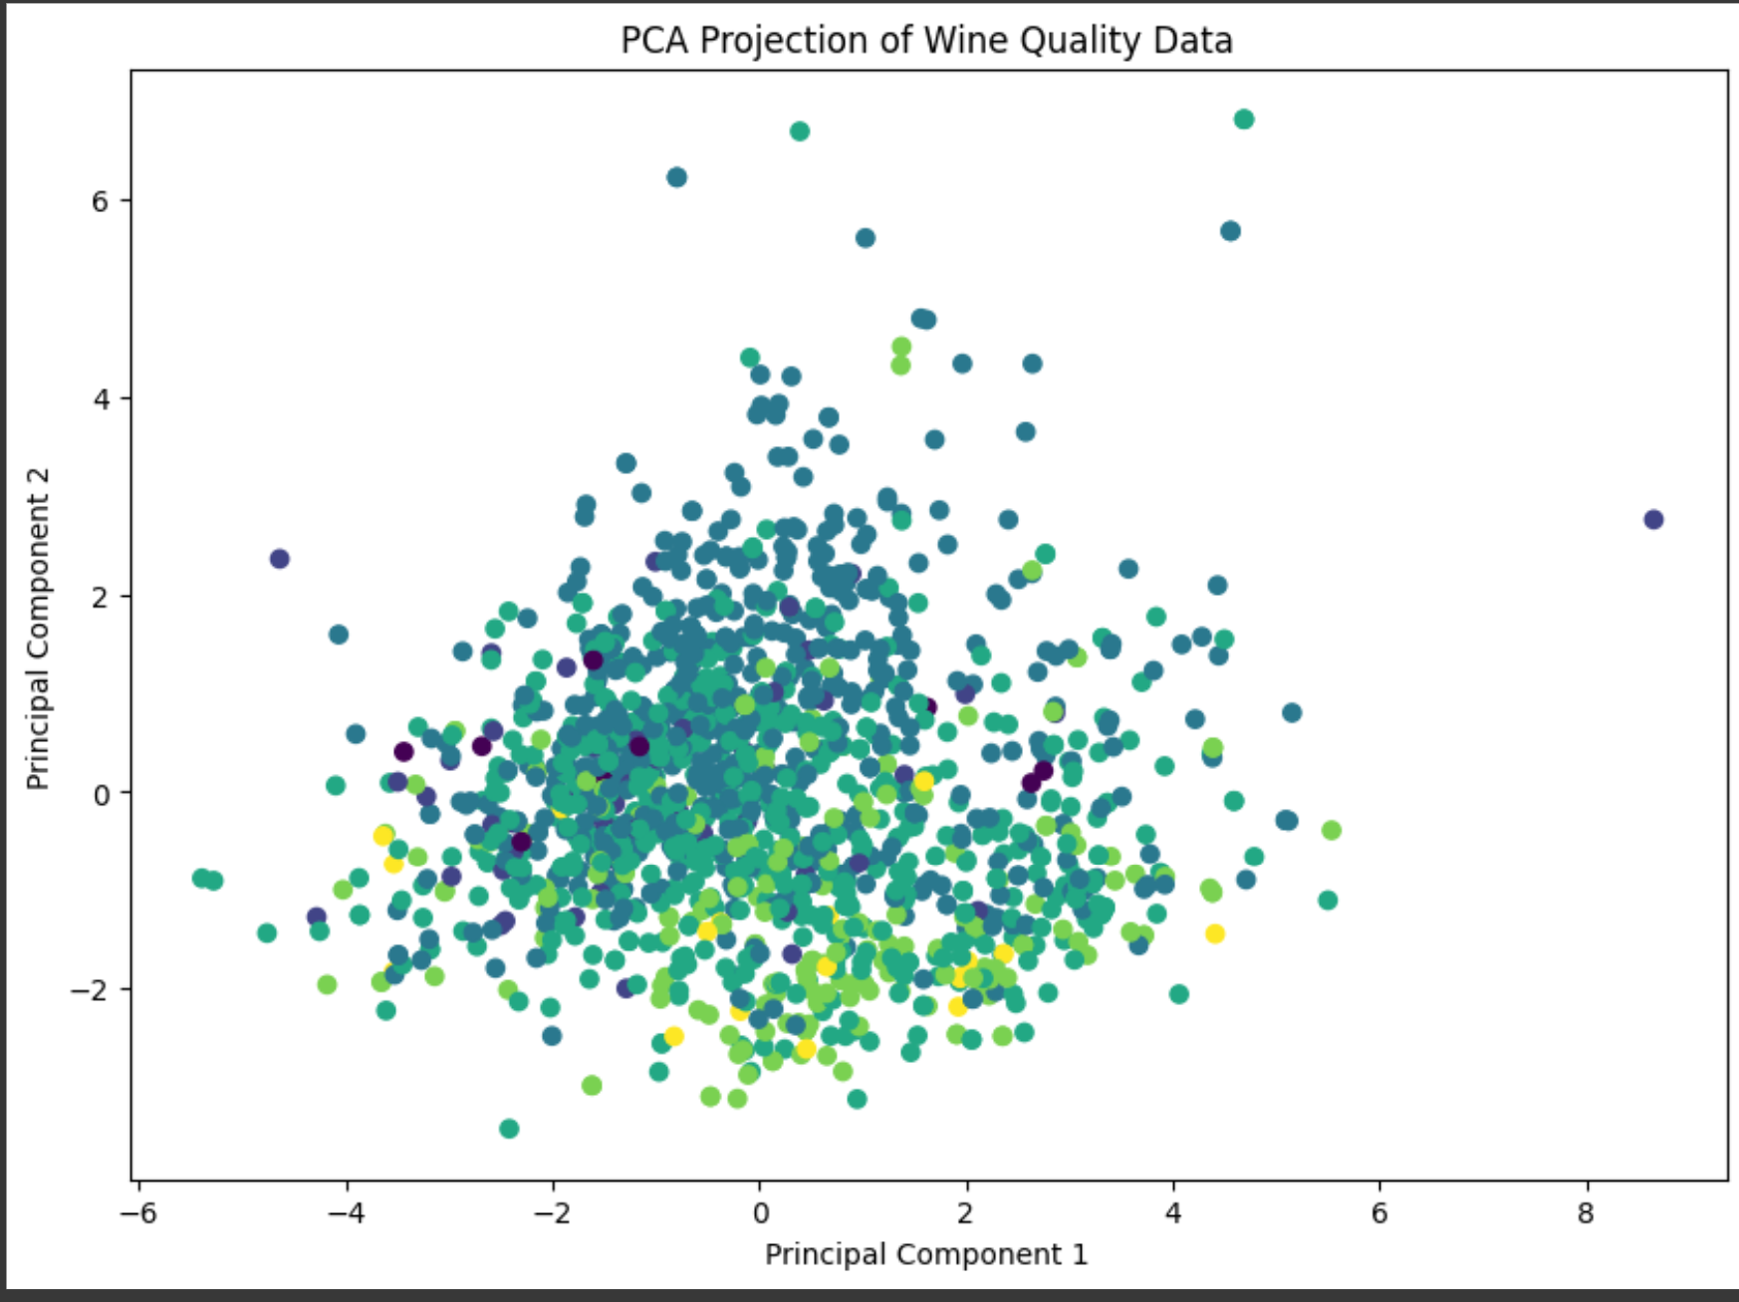
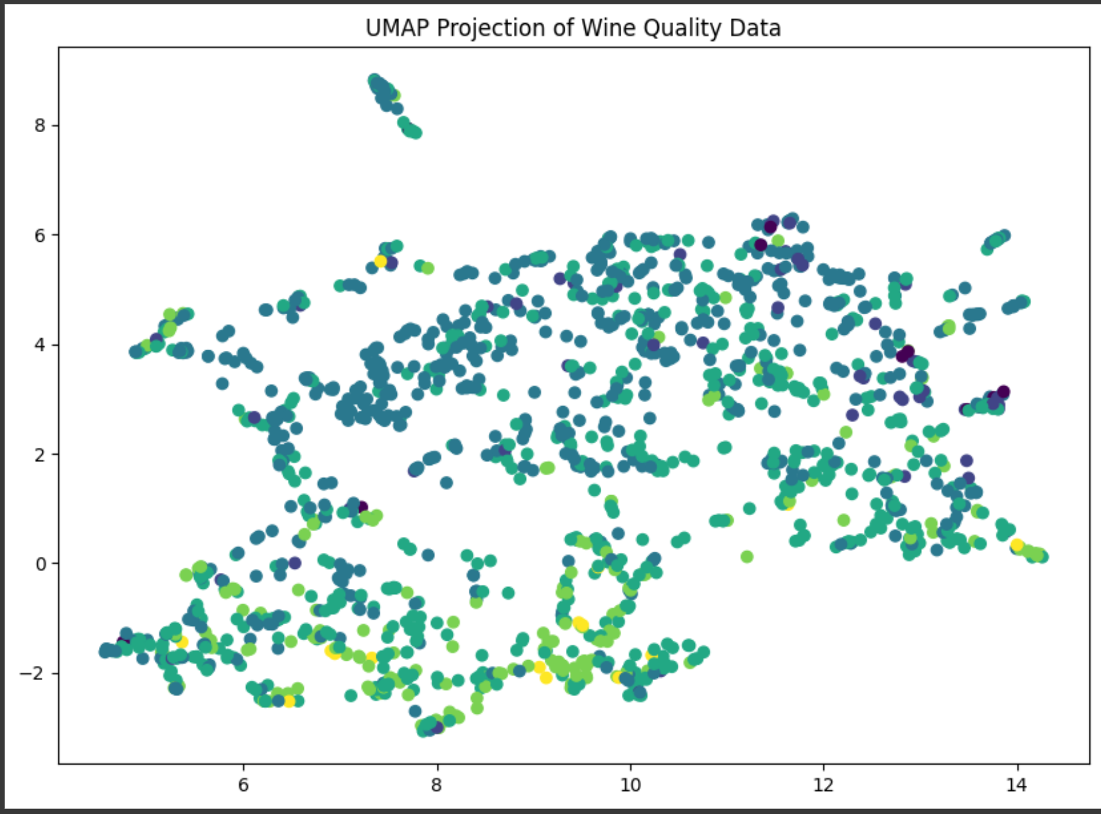
Visualising the data after dimensionality reduction
We have used PCA, UMAP, and t-Sne for dimensionality reduction and visulaised using a scatter plot

Slide 5
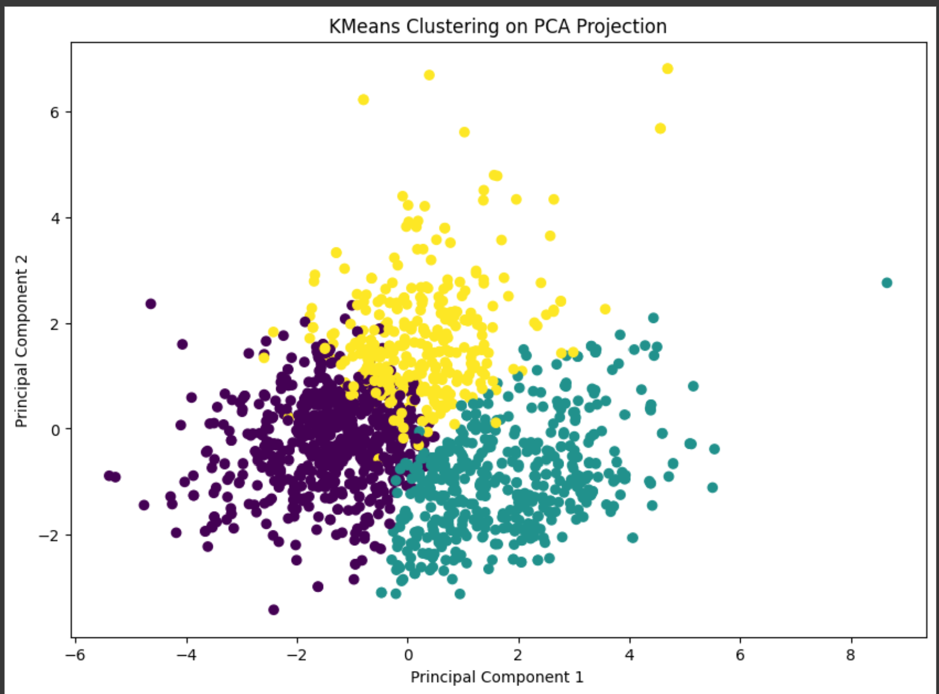
Implementing an unsupervised Learning algorithm
We chose Kmeans Clustering algorithm for this task.

Slide 6
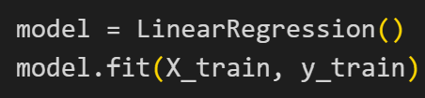
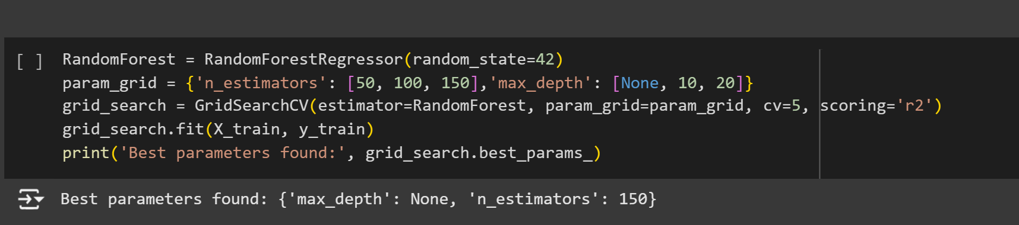
Simple Supervised Learning Model
We chose linear regression model for this.
Tuning Hyperparameters

Slide 7

Improving the performance
Improving the feature selection
1
Using better regularisation methods(lasso and ridge)
2

